Slide 1
Moving Digital Interaction
Beyond Keyboard & Mouse
Notes:
"Elevate Customer Engagement:
"Transform Your User Experience:
"Lead with Innovation:
"Revolutionize Engagement:
"Next-Level Interaction
"Futuristic Control for Today's Customers:
"Set New Standards in User Experience:
"Empower Your Digital Landscape:
"Redefine Digital Interaction:

Slide 2
Presenters
Alex Dunn
Founder/CEO
Julia Franklin
CLO/Speech Language Pathologist

Slide 3
What Cephable Does
Writing & Editing
Virtual Buttons
Browse the Internet
Voice Controls
Play Games
Facial Expressions
Post on Social Media
Head Motion
Give Presentations
Switches
Write Code
Device Motion

Slide 4
No New Hardware Required!
Use your existing camera and microphone
Windows or Mac

Slide 5
Cephable in Action
Watch 2 min user video & read full text description

Slide 6
Cephable was built for
Individuals
Free to the end user
Non-Commercial Use
Removing the Disability Tax
Companies with Inclusive Goals
Annual License Fee
Integrates with existing digital platforms
Meets a variety of business goals

Slide 7
Privacy & Security
Data Privacy: Controls & settings are only managed by your account
Camera and Microphone: Expression and voice controls run entirely offline. Audio and video are never recorded or streamed.
Offline: Personalized controls use machine learning entirely offline

Slide 8
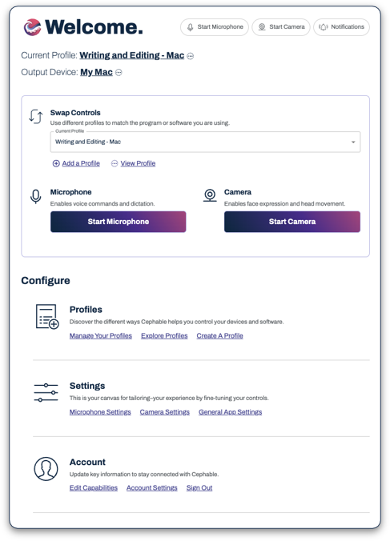
Live Look

Slide 9
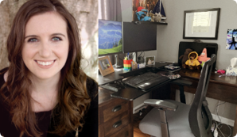
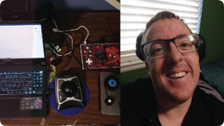
User Stories
Law student who simplified her suite of 10+ AT tools​
​
Technical writer needs options during her chronic pain flare ups​
​
Competitive adult gamer layered new voice inputs w/ his keyboard
Sales executive who broke both of her arms skiing ​
A teen’s first experience playing a browser game​
PhD dissertation – left arm amputee – overuse in right hand – carpel tunnel​

Slide 10
Cephable Value
Multiple types of Assistive Technology within 1 app
Increases Productivity
Promotes Independence
Improves Employability
Supports any disability, visible/invisible
Customizable options for Permanent, Temporary, Progressive, or Episodic Disabilities

Slide 11
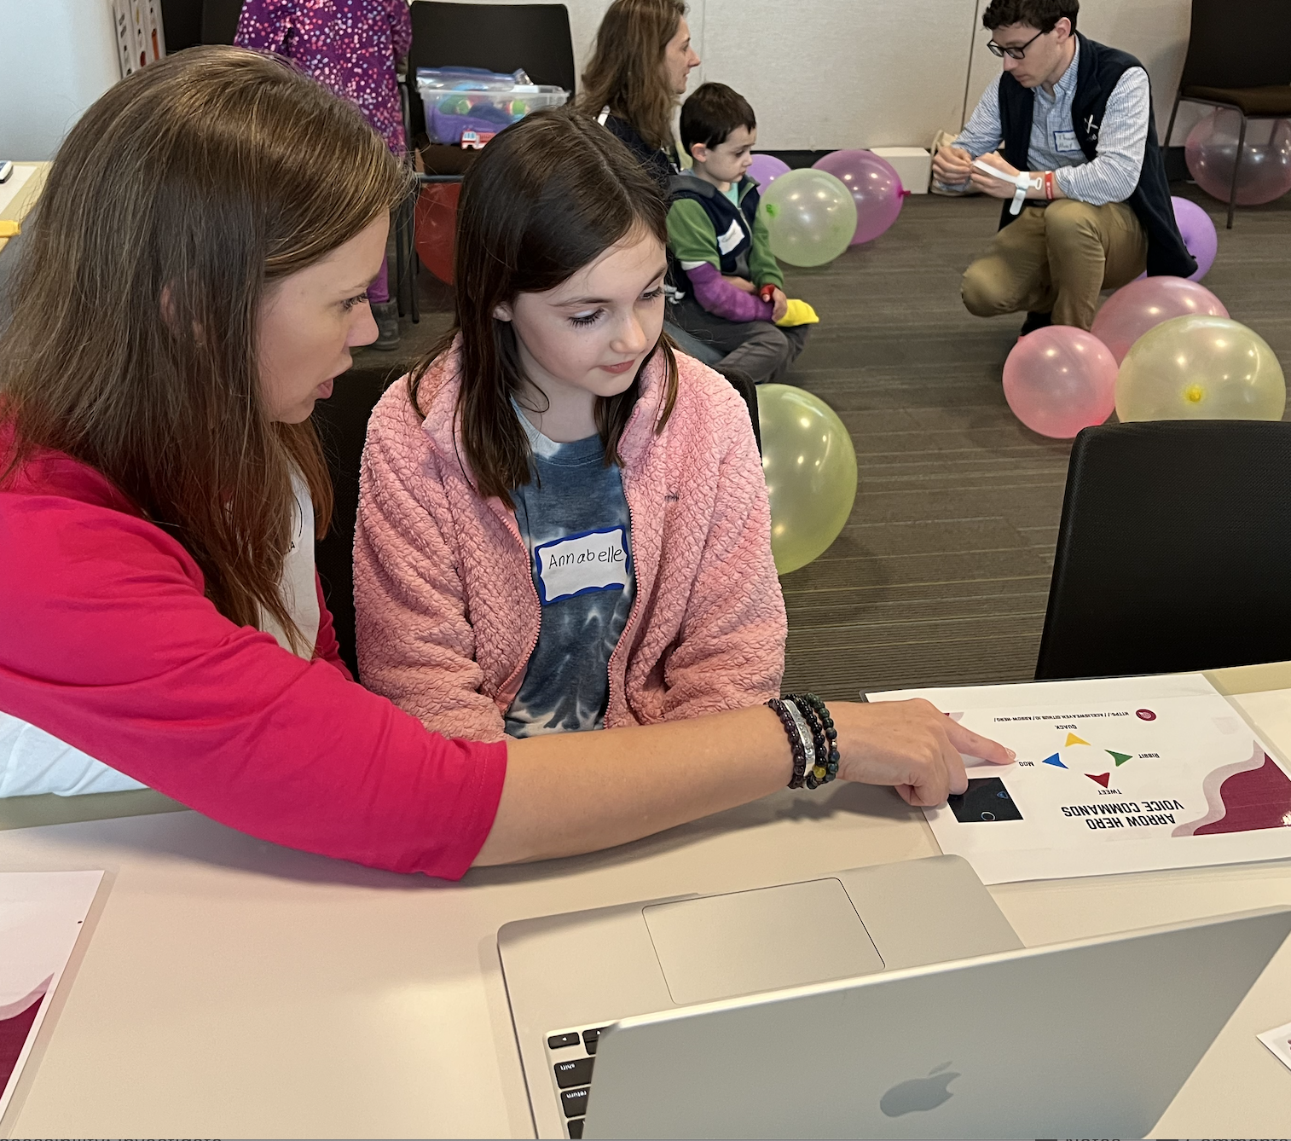
Cephable with Kids?
What we’ve learned & where we are going.
Pre-requisite Skills
Computer Basics (keyboard/mouse)
Understanding of age level programs/apps
Cause/Effect
Tech saavy caregiver / clinician
Learning curve / current state of Cephable
Setting up students for success (e.g. one click games)

Slide 12
Join our Mission
Individuals ​& Power Users | Partner Organizations | Businesses Enterprises
Free for non-commercial use​ Augment or replace keyboard & mouse​ Consortium: User Advisory Board​. Collaborative product planning with engineering team​ | Non-revenue partnerships with disability industry community organizations Newsletters, thought leadership, online tool listings, live demo labs, webinars ​ Reciprocal Value​ | Annual License Fee API Integrations Employee Accommodations Accessibility for Customers Beyond Keyboard & Mouse

Slide 13
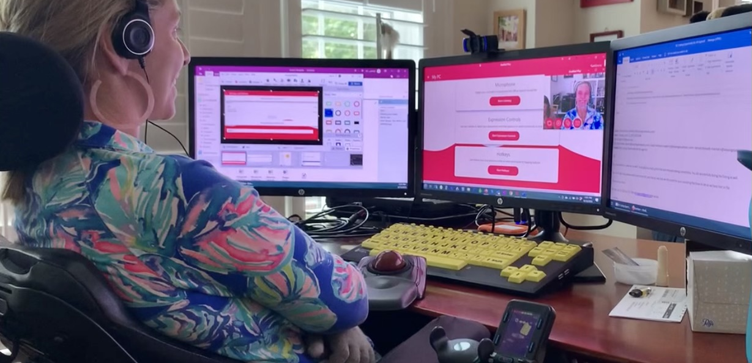
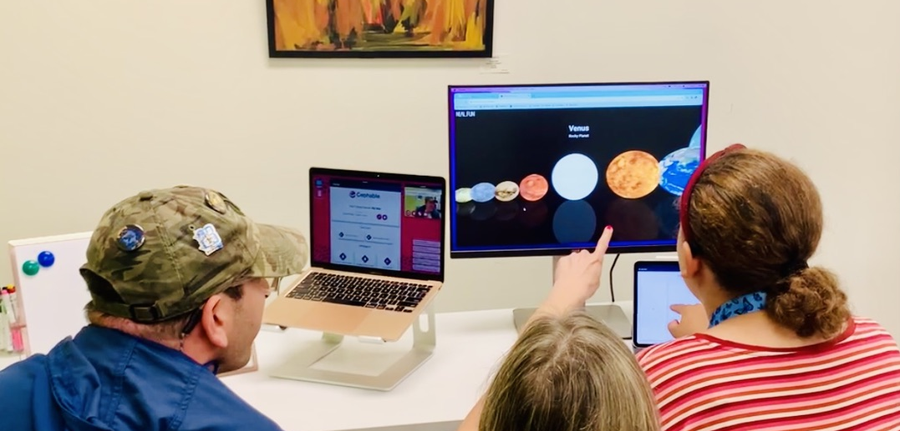
Our Community & Customers
Individuals & Power Users
Partner Organizations
Businesses
Enterprises
North Carolina Assistive Technology Program

Slide 14
Consortium – Nominate a Power User​
-Adults, 18+ with a disability (visible/invisible)​
-Tech Savvy​
-Regularly uses a computer (PC/Mac)​
-Uses Cephable in their daily life​
-Enjoys problem solving and providing feedback
​
-Eager to get personalized support from our engineering team.
**Learn more about the Consortium!
​

